Slide 1
Module IV - Data Science Basics
Importing Packages
Loading Data
Pandas DataFrames
Exploratory Data Analysis (EDA)
Visualizations
Data Cleaning & Processing
Saving Data
Saving Visuals
Classification with Decision Trees

Slide 2
Data Science Basics
Importing Packages & Loading Data
Python offers a substantial number of packages and libraries that can be installed and easily used for Data Science purposes. On a regular basis, new packages are released capable of speeding up various processes and providing new algorithms for machine learning.

Slide 3
Importing & Loading
Useful Packages
Pickle / OS / Glob
Pandas / NumPy / SciKit Learn / ImbLearn
Tensorflow / PyTorch / Keras
AdaptNLP / SweetViz / PandasProfiling
Data Loading There is a longer, Pythonic method of reading in data and there is the Pandas method of reading in data.
OS/Glob are packages that provide easy access to your operating system from a notebook and they can be used to read in large volumes of files from a directory (or multiple directories).
Most forms of saved data can be read in -- CSV, Excel Sheets, JSON, DSV file types

Slide 4
Data Science Basics
Pandas & Pandas DataFrames
Dataframes are a 2-dimensional labeled data structure with columns of containing data. A dataframe can contain different types at once, including dictionaries, lists, arrays, and series. This is the most used Pandas object as it lends itself towards use for data science as they are reminiscent of a spreadsheet or SQL table.

Slide 5
Dataframe Actions
Creating Dataframes
Can be created from Series; Lists
Dataframes can be Merged / Concatenated / .Explode()
Functions for Dataframes
Viewing Large DataFrames -- .head(), .tail()
Renaming & Reordering Columns
Indices -- Location Indexing (.iloc, .loc); Setting & Resetting the Index Hierarchical Indices

Slide 6
Data Science Basics
Exploratory Data Analysis (EDA)
Tell a story with the exploration you’re completing
Find things that could be problems worth solving
Explore how you got there and note questions you want SMEs to answer
Use EDA as an opportunity to probe a client on areas of interest to them.
EDA should be quick and dirty.

Slide 7
Exploratory Data Analysis
Some Obvious Summary Stats
Summary Stats -- .describe()
Histogram -- .hist()
Plot the Data → Create visual representations of the data
New Tools to Improve the Process
PandasProfiling
SweetViz
AutoViz
dataprep.EDA
Understanding the raw data is crucial to properly cleaning, processing, and analyzing the data

Slide 8
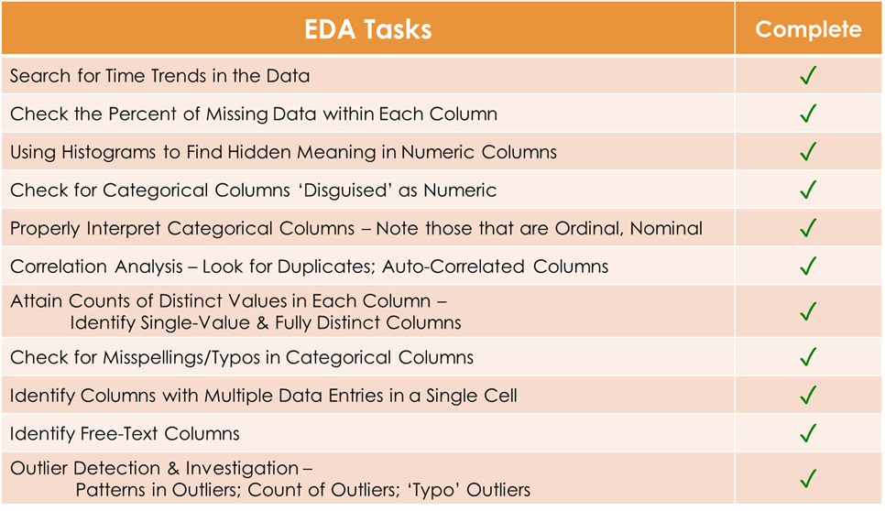
Exploratory Data Analysis Checklist
Notes:
Each step along this process involves different decision-making that will definitively affect results of the model.

Slide 9
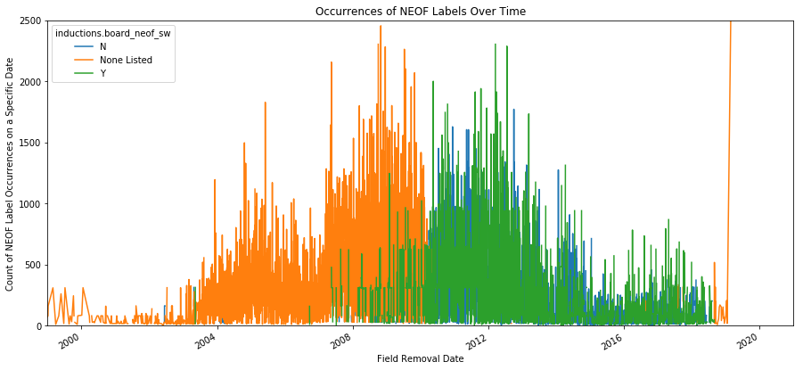
EDA Outcomes:Critical Understanding of Data
Count of Occurrences of Part Failure Over Time
Part Failure
Y
Blank
N
Count of Occurences
Date
Notes:
If dates are present in your data, be sure to plot data points along dates -- interesting patterns can be found

Slide 10
Data Science Basics
Visualizations
Visualizations continue to be heavily useful beyond initial EDA stages. They help “fact-check” changes in the data (through cleaning or processing steps), allow you to explore new areas of interest quickly, and highlight model outputs to a client.

Slide 11
Visualizations
Many, Many Options with Equally Many Variations
Start by Picking a Visual
Decide on the type of visual you need to achieve a goal.
Then, Pick a Visual Package to Use:
Plotly / Seaborn / Bokeh / Matplotlib
D3.js / Kepler.gl / Interactive Widgets
Now, Where to Start Coding?
Most visual packages provide very good example code that are great copy/paste starters. Each package offers a ton of customization. (Since there is a course dedicated to visualizing and analyzing data, we will not deep dive.)
In the end...
Stack Overflow is your friend. The Package Documentation is an even better friend.

Slide 12
Data Science Basics
Data Cleaning & Processing
Following what, ideally, is extensive deep-dives into the data through EDA, the understanding you now have of the dataset should enable you to begin cleaning and prepping the data for model applications.
These slides will provide background on frequently used cleaning and processing topics for model development. After these slides, we will cover the how-to applications of each topic in Python.

Slide 13
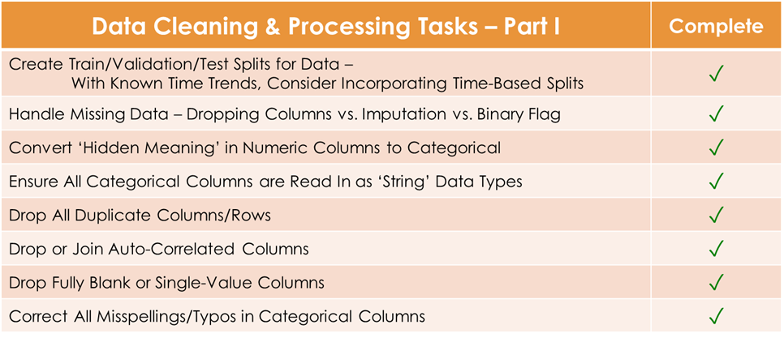
From EDA to Data Cleaning & Processing

Slide 14
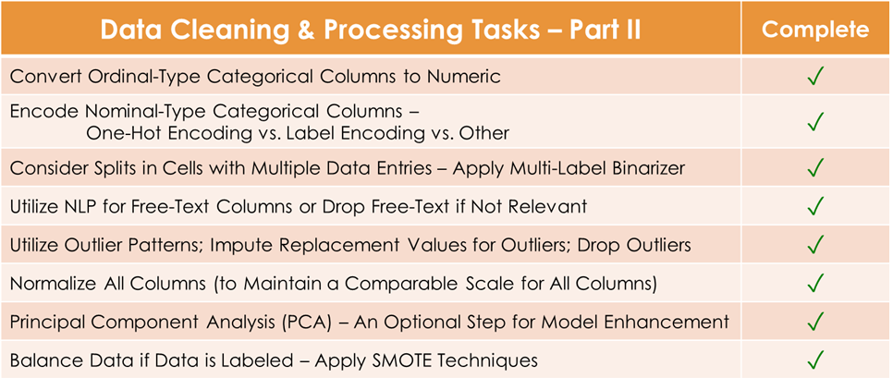
From EDA to Data Cleaning & Processing
Notes:
We’re going to briefly cover a couple of the tasks where the decisions you make have pretty significant impacts on the model.
Now, throughout this process, you may feel as though we are ‘gaming the system’. This is both true and clearly a problem! But there is one REALLY important way to address this: Split your data properly.

Slide 15
Data Cleaning & Processing
Notes:
If your data is split properly, this ‘gaming’ you feel is happening will be caught in the TEST SET run.

Slide 16
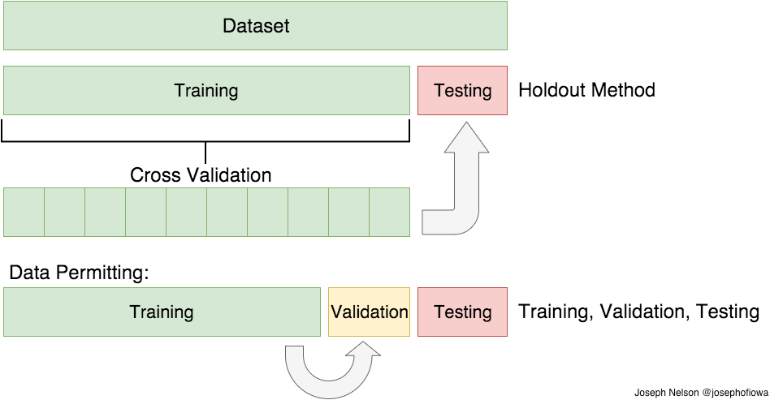
The Dataset Must Be Split for Model Training
To properly train algorithms (and select the best performing!), the data must be sectioned out to teach the algorithm where to focus and what to identify.
Splits are generally randomized subsets of the data: 1. A sizeable ‘Training Set’ to first teach the model. 2. A smaller set for ‘Validation’ -- to measure the performance of the algorithm on the Training Set. 3. The Training & Validation sets are then combined to create the ‘Full-Training Set’ -- to allow the algorithm to run on a slightly larger set for improvement. 4. The ‘Test Set’ then measures the performance of the fully-trained algorithm on the Full-Training data set.

Slide 17
The Dataset Must Be Split for Model Training
You are starting with a full dataset.
Your Goal:
Train a model that can be used for predictions on real-time data.
How can you determine how your model will perform in the future?

Slide 18
The Dataset Must Be Split for Model Training
The first step is always to set aside a portion of the data from the full set.
This set is called your ‘Test Set’ and will be used to simulate real-time or future data once model training is complete.

Slide 19
The Dataset Must Be Split for Model Training
BUT, with the many decisions and parameter tuning that is done, you could find yourself training a model to be amazing at predicting on the Test Set.
This is Overfitting.
When a model has been Overfit, the model will fail on real-time/future data.

Slide 20

Decisions made prior to model implementation have massive impacts on the output of a model.
It is incredibly easy to miss something simple and create an ill-functioning model, despite the accuracy score.
Notes:
So, if you walk away from here with only one new thing, let it be to: ALWAYS ask how someone split their data -- if they only used Training/Test, trusting that model is a bad idea

Slide 21
The Dataset Must Be Split for Model Training
Solution: Completely separate the Test Set from the Decision-Making Process.
This means the Test Set is unexposed to Data Processing, Algorithm Selection, and HyperParameter Tuning.
The Decision-Making Process should be checked on either a Validation Set or the model should utilize Cross-Fold Validation.
Notes:
Cross-Fold Validation creates subsets of the Training Set; trains the Algorithm on each subset individually; then these subset results are averaged or used to create a range to provide a more informative algorithm metric to compare to the Test Set.

Slide 22
The Dataset Must Be Split for Model Training
Solution: Completely separate the Test Set from the Decision-Making Process.
This means the Test Set is unexposed to Data Processing, Algorithm Selection, and HyperParameter Tuning.
The Decision-Making Process should be checked on either a Validation Set or the model should utilize Cross-Fold Validation.
V
Training
Notes:
Cross-Fold Validation creates subsets of the Training Set; trains the Algorithm on each subset individually; then these subset results are averaged or used to create a range to provide a more informative algorithm metric to compare to the Test Set.

Slide 23
The Dataset Must Be Split for Model Training
Solution: Completely separate the Test Set from the Decision-Making Process.
This means the Test Set is unexposed to Data Processing, Algorithm Selection, and HyperParameter Tuning.
The Decision-Making Process should be checked on either a Validation Set or the model should utilize Cross-Fold Validation.
V
Training
Notes:
Cross-Fold Validation creates subsets of the Training Set; trains the Algorithm on each subset individually; then these subset results are averaged or used to create a range to provide a more informative algorithm metric to compare to the Test Set.

Slide 24
The Dataset Must Be Split for Model Training
Solution: Completely separate the Test Set from the Decision-Making Process.
This means the Test Set is unexposed to Data Processing, Algorithm Selection, and HyperParameter Tuning.
The Decision-Making Process should be checked on either a Validation Set or the model should utilize Cross-Fold Validation.
V
Training
Notes:
Cross-Fold Validation creates subsets of the Training Set; trains the Algorithm on each subset individually; then these subset results are averaged or used to create a range to provide a more informative algorithm metric to compare to the Test Set.

Slide 25
The Dataset Must Be Split for Model Training
Solution: Completely separate the Test Set from the Decision-Making Process.
This means the Test Set is unexposed to Data Processing, Algorithm Selection, and HyperParameter Tuning.
The Decision-Making Process should be checked on either a Validation Set or the model should utilize Cross-Fold Validation.
V
Training
Notes:
Cross-Fold Validation creates subsets of the Training Set; trains the Algorithm on each subset individually; then these subset results are averaged or used to create a range to provide a more informative algorithm metric to compare to the Test Set.

Slide 26
The Dataset Must Be Split for Model Training
Solution: Completely separate the Test Set from the Decision-Making Process.
This means the Test Set is unexposed to Data Processing, Algorithm Selection, and HyperParameter Tuning.
The Decision-Making Process should be checked on either a Validation Set or the model should utilize Cross-Fold Validation.
V
Training
Notes:
Cross-Fold Validation creates subsets of the Training Set; trains the Algorithm on each subset individually; then these subset results are averaged or used to create a range to provide a more informative algorithm metric to compare to the Test Set.

Slide 27
The Dataset Must Be Split for Model Training
Solution: Completely separate the Test Set from the Decision-Making Process.
This means the Test Set is unexposed to Data Processing, Algorithm Selection, and HyperParameter Tuning.
The Decision-Making Process should be checked on either a Validation Set or the model should utilize Cross-Fold Validation.
V
Training
Notes:
Cross-Fold Validation creates subsets of the Training Set; trains the Algorithm on each subset individually; then these subset results are averaged or used to create a range to provide a more informative algorithm metric to compare to the Test Set.

Slide 28
The Dataset Must Be Split for Model Training
Solution: Completely separate the Test Set from the Decision-Making Process.
This means the Test Set is unexposed to Data Processing, Algorithm Selection, and HyperParameter Tuning.
The Decision-Making Process should be checked on either a Validation Set or the model should utilize Cross-Fold Validation.
V
Training
Notes:
Cross-Fold Validation creates subsets of the Training Set; trains the Algorithm on each subset individually; then these subset results are averaged or used to create a range to provide a more informative algorithm metric to compare to the Test Set.

Slide 29
The Dataset Must Be Split for Model Training
Solution: Completely separate the Test Set from the Decision-Making Process.
This means the Test Set is unexposed to Data Processing, Algorithm Selection, and HyperParameter Tuning.
The Decision-Making Process should be checked on either a Validation Set or the model should utilize Cross-Fold Validation.
V
Notes:
Cross-Fold Validation creates subsets of the Training Set; trains the Algorithm on each subset individually; then these subset results are averaged or used to create a range to provide a more informative algorithm metric to compare to the Test Set.

Slide 30
The Dataset Must Be Split for Model Training
Solution: Completely separate the Test Set from the Decision-Making Process.
This means the Test Set is unexposed to Data Processing, Algorithm Selection, and HyperParameter Tuning.
The Decision-Making Process should be checked on either a Validation Set or the model should utilize Cross-Fold Validation.
V
Notes:
Cross-Fold Validation creates subsets of the Training Set; trains the Algorithm on each subset individually; then these subset results are averaged or used to create a range to provide a more informative algorithm metric to compare to the Test Set.

Slide 31
The Dataset Must Be Split for Model Training
Solution: Completely separate the Test Set from the Decision-Making Process.
This means the Test Set is unexposed to Data Processing, Algorithm Selection, and HyperParameter Tuning.
The Decision-Making Process should be checked on either a Validation Set or the model should utilize Cross-Fold Validation.
V
Notes:
Cross-Fold Validation creates subsets of the Training Set; trains the Algorithm on each subset individually; then these subset results are averaged or used to create a range to provide a more informative algorithm metric to compare to the Test Set.

Slide 32
The Dataset Must Be Split -- But there are challenges
Challenges for Proper Data Splits
Records may not be entirely unique and must be grouped together, even when splitting randomly between training and test sets.
e.g. A single container could be deemed ‘nefarious’, but may be grouped by a shipment’s ‘Bill of Lading’. (Complete information on containers is grouped.)
Human behavior creates trends over time in how ‘nefarious’ objects could be identified -- patterns over time must be viewed together by the model.
Notes:
However, we still run into challenges!

Slide 33
The Dataset Must Be Split -- But there are challenges
Challenges for Proper Data Splits
The model’s intended purpose is to train on the past in order to predict on real-time data -- and there’s no accounting for dates here.
Without proper splitting, these would result in very high model scores, but the model would perform very poorly on real-time predictions!
Notes:
However, we still run into challenges!

Slide 34

Decisions made prior to model implementation have massive impacts on the output of a model.
It is incredibly easy to miss something simple and create an ill-functioning model, despite the accuracy score.
Notes:
This kind of linking among columns in the dataset is easy to overlook

Slide 35
The Dataset Must Be Split -- Challenge Workaround
Solution: Create time-based splits in the dataset.
This inherently keeps records grouped together as needed to identify patterns and retain maximum information about individual records. (All containers associated with a ‘Bill of Lading’ would be evaluated in the same data subset.)
Cross-Validation would not work for this new time-split method; we developed our own code for a ‘Multi-Fold Validation’.
Notes:
Once taking into account time-based splits, we found we needed to develop a new form of cross-validation. Our form is known as multi-fold validation.

Slide 36
The Dataset Must Be Split -- Challenge Workaround
Solution: Create time-based splits in the dataset.
‘Multi-Fold Validation’ works by simply running the model on even smaller subsets of the training data to produce a ‘subset model result’ for each one.
Each subset models’ results are then averaged to provide a single usable metric to measure the model’s performance.
Optionally, instead of an average, the range of results can be provided instead.
Training
V
Notes:
This works by running on smaller subsets of data to produce a subset model run result to then later average (or range) all of these smaller results into an usable metric to measure the model.
This captures changes across time and human behavior

Slide 37
The Dataset Must Be Split -- Challenge Workaround
Solution: Create time-based splits in the dataset.
‘Multi-Fold Validation’ works by simply running the model on even smaller subsets of the training data to produce a ‘subset model result’ for each one.
Each subset models’ results are then averaged to provide a single usable metric to measure the model’s performance.
Optionally, instead of an average, the range of results can be provided instead.
Training
V
Notes:
This works by running on smaller subsets of data to produce a subset model run result to then later average (or range) all of these smaller results into an usable metric to measure the model.
This captures changes across time and human behavior

Slide 38
The Dataset Must Be Split -- Challenge Workaround
Solution: Create time-based splits in the dataset.
‘Multi-Fold Validation’ works by simply running the model on even smaller subsets of the training data to produce a ‘subset model result’ for each one.
Each subset models’ results are then averaged to provide a single usable metric to measure the model’s performance.
Optionally, instead of an average, the range of results can be provided instead.
Training
V
Notes:
This works by running on smaller subsets of data to produce a subset model run result to then later average (or range) all of these smaller results into an usable metric to measure the model.
This captures changes across time and human behavior

Slide 39
The Dataset Must Be Split -- Challenge Workaround
Solution: Create time-based splits in the dataset.
‘Multi-Fold Validation’ works by simply running the model on even smaller subsets of the training data to produce a ‘subset model result’ for each one.
Each subset models’ results are then averaged to provide a single usable metric to measure the model’s performance.
Optionally, instead of an average, the range of results can be provided instead.
Training
V
Notes:
This works by running on smaller subsets of data to produce a subset model run result to then later average (or range) all of these smaller results into an usable metric to measure the model.
This captures changes across time and human behavior

Slide 40
The Dataset Must Be Split -- Challenge Workaround
Solution: Create time-based splits in the dataset.
This works to capture changes over time as well as changes in human behavior.
Training
V

Slide 41
Data Cleaning & Processing

Slide 42
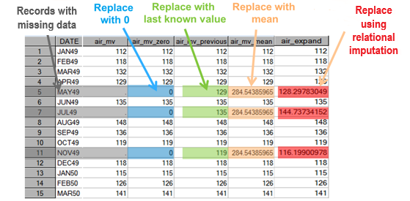
Traditional Handling of ‘Missing’ Data
Filling in Data ‘Blanks’
Most Machine Learning/Deep Learning models will not run with blanks in the data.
Each feature must be addressed on a case-by-case basis.
What are our options?

Slide 43
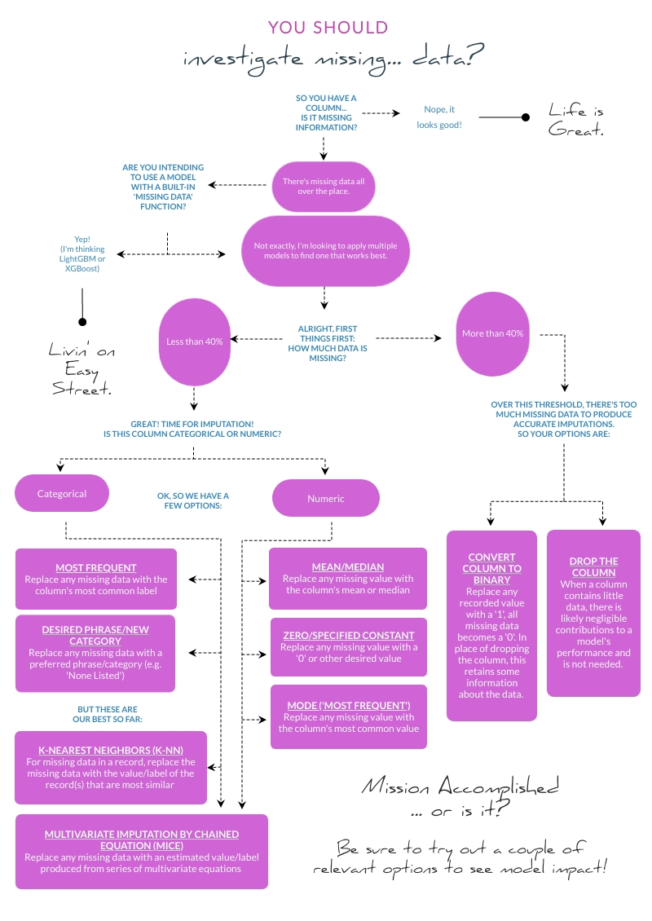
Advanced Handling of ‘Missing’ Data
Notes:
Discuss Percentage of Missing Data (and generally accepted thresholds) don’t always work best for every project Discuss MICE as a very solid op

Slide 44
Data Cleaning & Processing

Slide 45
Handling Redundant or Duplicate Information
Some columns repeat information contained in other columns.
If columns are derived from or are directly related to another column(s), this can create autocorrelation issues within the model.
Autocorrelation generally refers to ‘patterns’ that are improperly identified by an algorithm. These incorrect patterns will result in increased error and decreased precision.
For example, if a column was created to mark “Tall” or “Short” and is based on an existing column of height values, a model could relate both the Tall_Short column to the Height_Value column as a pattern that affects the variable being predicted.

Slide 46
Handling Redundant or Duplicate Information
Some columns repeat information contained in other columns.
Not only can repeat information negatively affect the performance of a model, but redundant information and/or non-relevant columns also creates significant slow-downs in the runtime of a model.

Slide 47
Handling Redundant or Duplicate Information
Solutions can be fairly simple.
Beware the nature of the columns that are being feature engineered -- is the new column simply repeating the exact information in a different form? Or is the column providing new information about an event?
Using the speed and location of vehicles to calculate the speed a vehicle was traveling creates new, valuable information for a model.
Creating a separate column re-organizing the age groups of another column may not.
Identify features that are relevant to the model’s ability to predict -- through human knowledge or through statistical approaches like Stepwise Regression or PCA.
The gift received on a birthday would not affect the likelihood of an individual getting cancer.
It is also valuable to drop columns (or rows) of information that are entirely redundant.
There’s no need to repeat an exactly replicated row or column, the data has been captured.
If a column is created to group ages differently, simply drop the original row.

Slide 48
Data Cleaning & Processing
Notes:
We learned to check this after we made a mistake in our own work.
In programming language, a ‘string’ refers to any non-numeric value or text. A ‘string’ is more-or-less a phrase.

Slide 49
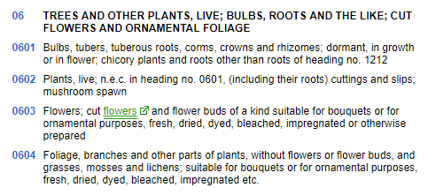
Ensure Categorical Columns are Read in As Strings
The HS Code Problem
In this case, we made a decision that had consequences similar to our previous Tank ML Dud from earlier.
We chose to separate the true positives from a random sample of the non-positives due to a data imbalance (very few True Positives to a great many Non-Positives).
This decision was not trivial and will likely be made in many other cases in the future.
Notes:
We will address Data Imbalances in a little bit

Slide 50
Ensure Categorical Columns are Read in As Strings
The HS Code Problem
An HS Code is simply an identifier for the type of item that is in a shipment container.
An HS Code is numeric in text, but does not have a numeric meaning.
However, oftentimes, datasets will be read in with the column types assigned improperly. What should be a categorical (or ‘string’ type) may be read in as numeric (a ‘float’ or ‘int’ type).

Slide 51
Ensure Categorical Columns are Read in As Strings
True Positives
The HS Code Problem
As the data was read in, the HS Codes of the True Positive set were incorrectly deemed numeric resulting in the leading zeros being dropped.
In the Non-Positive set, the HS Codes were treated appropriately as strings with the leading zeros retained.
Non-Positives
i.e. ‘0601’ becomes ‘601’

Slide 52
Ensure Categorical Columns are Read in As Strings
True Positives
Here’s the Kicker
Every time ‘601’ is seen by the model, the model links it to the True Positives.
Every time ‘0601’ is seen by the model, the model links it to the Non-Positives.
We just gave the model the answers.
Non-Positives

Slide 53
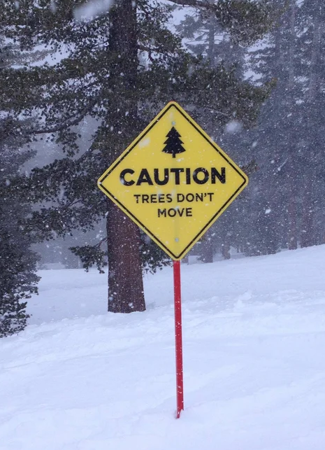
Decisions made prior to model implementation have massive impacts on the output of a model.
It is incredibly easy to miss something simple and create an ill-functioning model, despite the accuracy score.

Slide 54
Ensure Categorical Columns are Read in As Strings
Solution: One line of code added to the process to inform how the column should be treated across the whole dataset.
Not all challenges are difficult, but you have to be looking for them to find them.
All Data

Slide 55
Data Cleaning & Processing
Notes:
Encoding is essentially converting categorical information into a formal numeric format for the background mathematics to run on.
We’re very briefly covering this section because it is covered in every Data Science coursera course there is.

Slide 56
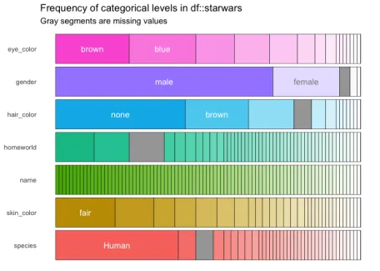
Ensure the Model can Properly Read Categorical Data:
Encoding!
So, we just said to ensure categorical columns are read as strings...
… But most Machine-Learning Algorithms require all columns to be in a numeric format for the algorithm to run.
Well, that’s annoying.

Slide 57
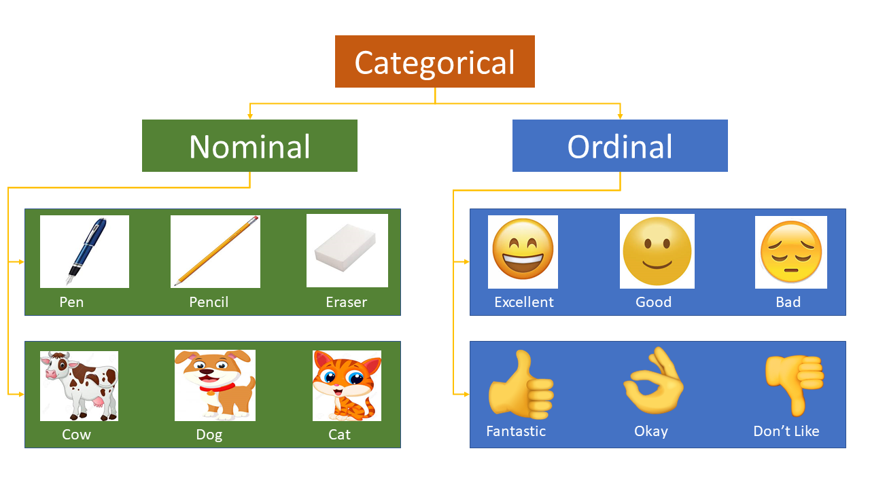
Two Types of Categorical Data

Slide 58
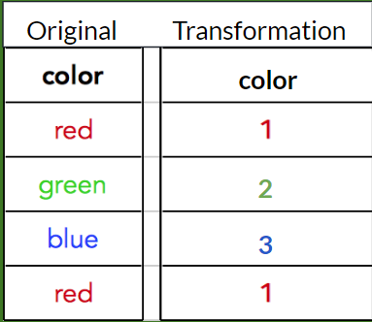
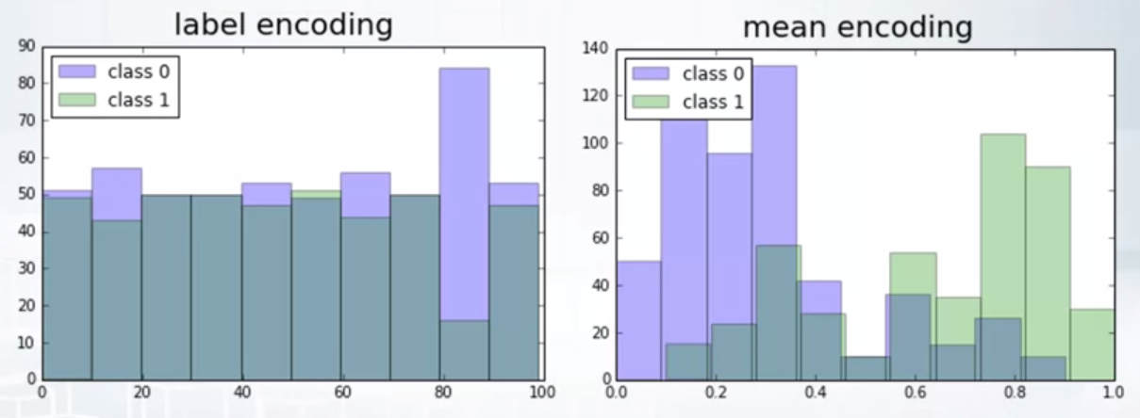
Traditional Encoding Methods - Not So Great
Label Encoding
Disadvantages
This encoding format creates a random relationship between the varying levels of a column when none should exist.
e.g. Red is interpreted as having a greater association with Green than it does with Blue
This encoding also creates a random correlation with the column’s levels and what is supposed to be predicted.
Notes:
We have a couple of options for Categorical Encoding; although they are heavily emphasized in courses, they’re actually really not all that great.

Slide 59
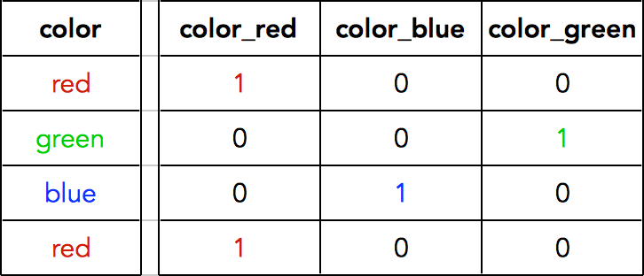
Traditional Encoding Methods - Not So Great
One-Hot Encoding / Dummy Encoding (i.e. split into separate columns)
Disadvantages
This encoding format does not help the model apply this categorical data effectively -- models see little improvement.
This method also artificially inflates the importance of categorical data in the model -- by increasing the presence of categorical data overall. (A dataset with 50 values in a column now has 50 new columns.)
Model training is much slower as a result of the above.
Original Transformation
Notes:
“Increasing the presence” refers to the creation of a column for every possible categorical outcome in the column. (A dataset with a column with 50 options now has 50 new columns)

Slide 60
Alternative Encoding Methods
Alternative Encodings
Neither of the previous encoding methods are satisfactory -- they can create model problems and decrease model performance.
No new best way to entirely replace the old.
There are up-and-coming options that prevent an exploding column count (enlarging the data) while maintaining accuracy.
Mean Encoding
At the end of the day, the method chosen is heavily dependent on which one best improves model performance.

Slide 61
Data Cleaning & Processing

Slide 62
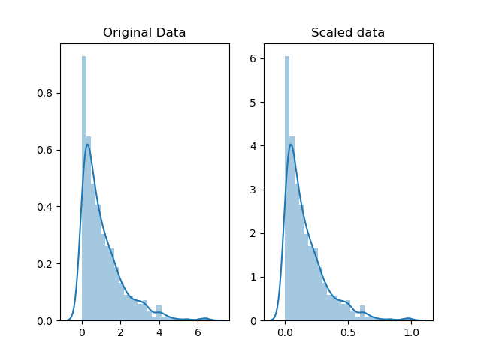
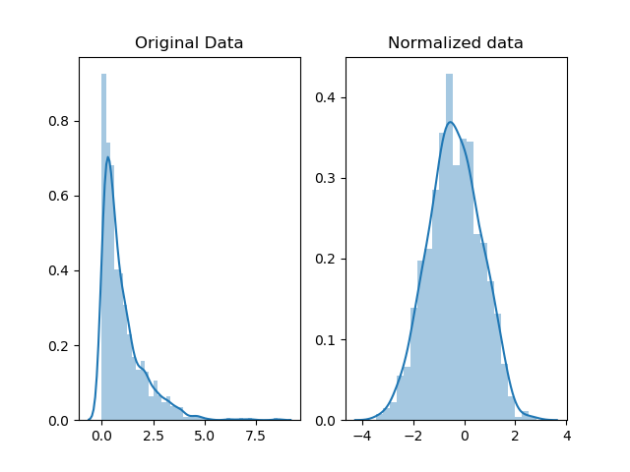
Normalization vs. ...Normalization?
Are you a Mathematician/Statistician? Normalization refers to a distributional correction.
Are you more of an Applied Data Analyst/Scientist? Normalization refers to scaling all numeric information from 0-1.
It is very important to keep in mind which ‘normalization’ is referenced in practice. Most often, normalization is referencing a scaling for algorithm processing.
Distributional Scaling
Notes:
Normalization translates both metrics (and all other numeric columns in a dataset) into one scale without losing the relational information within each individual column.
https://kharshit.github.io/blog/2018/03/23/scaling-vs-normalization

Slide 63
Normalization as Scaling
Numerical data must be scaled for a model to be able to compare the numeric values across different columns.
e.g. Height & Weight - recorded in feet & pounds
Normalization translates both metrics (and all other numeric columns in a dataset) into one scale without losing the relational information within each individual column.
Without this, the algorithm will improperly interpret relationships between the columns’ numeric values.
Note: This is not the same as transforming your data. (such as into log form)
Scaling

Slide 64
Data Cleaning & Processing

Slide 65

Principal Component Analysis (PCA)
PCA transforms data sets to a smaller number of columns that still retain most of the information.
PCA can speed up model training, but does not improve score. In fact, PCA may negatively impact the score.
Despite multiple sources and courses emphasizing the importance of PCA, we have yet to find it useful in practical applications.
If a model takes a little time to run, that’s fine.
If every run of hyperparameter optimization takes a couple of minutes, that is not good. PCA may be worth it.

Slide 66
Data Cleaning & Processing

Slide 67
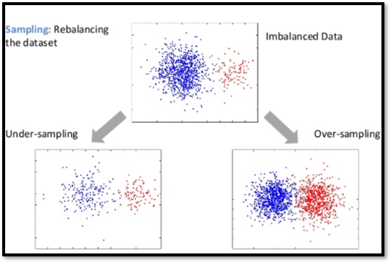
Data Balancing with SMOTE (Synthetic Minority Oversampling TEchnique)
In a dataset with labels, it is very likely that some labels are less common.
When this happens, the model performs well, but tends to ignore uncommon labels.
Data is 95% Blue.
The model would score 95% accuracy by saying every point is Blue.

Slide 68
Data Balancing with SMOTE (Synthetic Minority Oversampling TEchnique)
There are a couple of ways to address this:
1. Undersampling the majority class 2. Oversampling the minority class 3. A hybrid of the two
SMOTE is the leading approach, but there are multiple SMOTE algorithms to choose from:
SMOTE / SMOTEENN / SMOTETomek

Slide 69
Data Balancing with SMOTE (Synthetic Minority Oversampling TEchnique)
Can experience ~5% swings in accuracy based solely on the SMOTE approach applied.
When addressing a data imbalance, it is worth experimenting with multiple SMOTE options to identify the best performing method for a particular dataset and problem.

Slide 70
Data Science Basics
Saving Data & Figures
It is super easy to save data -- in a pickle, in JSON, or CSV. Saving data at the end of the process is as easy as one line of code.
Similarly, most figures and charts can be output and saved just as easily in one line of code. Alternatively, some figures may be large enough to screenshot, though this is not the recommended method.

Slide 71
Classification Models
Intro to Machine Learning
What is this difference between Supervised and Unsupervised learning?
Supervised learning is defined by labeled training data. Each instance of training data is categorized by a class or other value that we wish to train an algorithm to predict based on the feature attributes.
For unsupervised learning there are no training labels, instead we attempt to cluster the data.
Different types of Supervised learning – classification and regression.

Slide 72
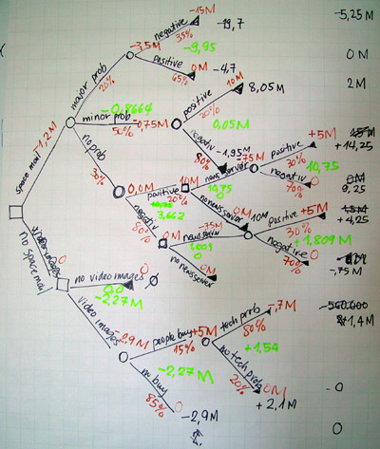
Classification with Decision Trees
A highly explainable tree-like model that can be used for classification.
The training process involves an algorithm that selects the most important feature attributes to the data on at each decision node. How is importance determined? There are various metrics such as GINI impurity and entropy.

Slide 73
Scikit Learn
Decision Tree Classifier
Prepare the data
Select hyperparameters
Train model and evaluate on validation set
Repeat steps 2-3 to improve validation accuracy (or other metrics)
Evaluate final model on test set
Important hyperparameters for Decision Trees: decision criterion, max depth, min samples (split), min samples (leaf)

Slide 74
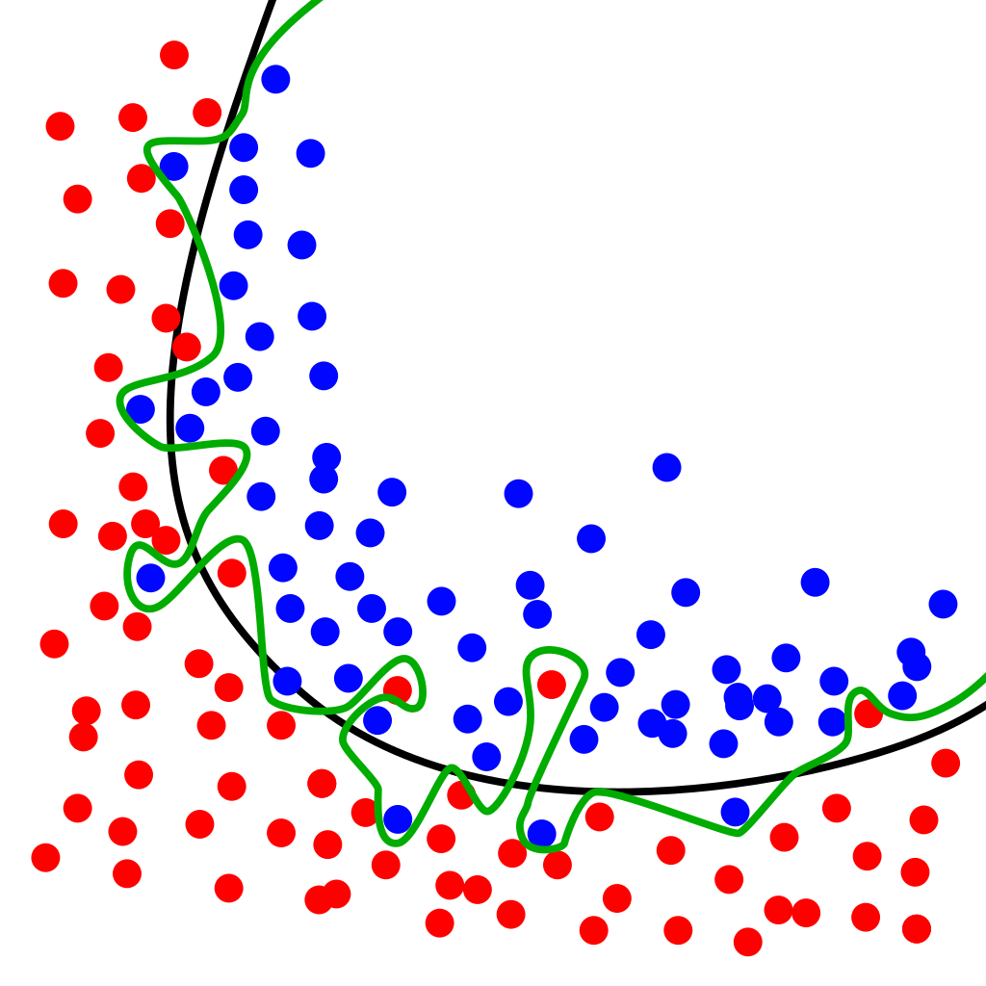
Over/under fitting
How well does our model generalize?
Overfitting occurs when the trained model corresponds too closely or exactly to the data used to train the model.
Underfitting occurs when the trained model cannot adequately generalize to the test data that the model has not seen during the training phase.
To prevent overfitting there are some options: hyperparameter tuning, bagging (Random Forest Trees), and ensemble methods to name a few.

